Slide 1
Hosting a Web Site

Slide 2
Web site hosting
Need to consider 3 things,
A domain name
DNS
A web host

Slide 3
Web Hosting
Web hosting refers to a service that makes your website available to your users.
In general, most websites are intended to be viewed by anyone on the Internet, at any time.
There are companies who specialize in web hosting so the work can be given to them so that the company can concentrate on there core business.
A good hosting companies will provide basic services like 24/7 support, 24/7 FTP access,24/7 FTP access, Email accounts, Online control panel, Online traffic statistics, database management system, such as MySQL

Slide 4
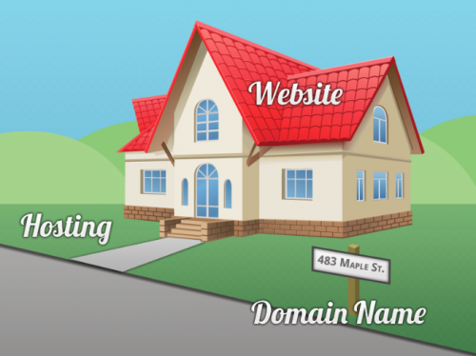
Are domain name and Web Hosting the Same?
You get a domain name, then
you get hosting, then you build
a website/create email addresses
Domain Name – The Address
Hosting – The Land
Website – The House

Slide 5
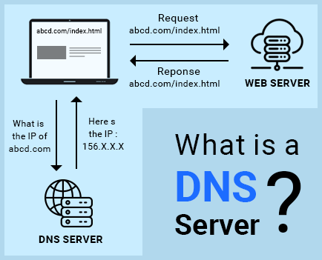
DNS – Domain Name System

Slide 6
DNS and Domain Names
It is problematic to remember IP addresses.
Solution : Web URL /Domain name
Computers remember numbers, and DNS helps to convert the URL into an IP address that the computer can understand.
When you type in domain.com into your browser, the browser first needs to get the IP address of www.domain.com.
The browser contacts a DNS server to query the location of the server where the webpages are stored.

Slide 7
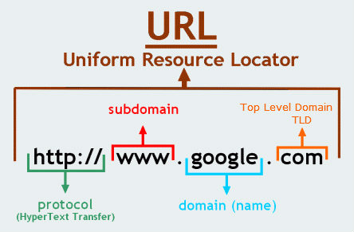
Domain Name
A domain is the name of your website. To host a site we need a domain.
examples: Google.com , Linux.org, eLearningEuropa.info, Yahoo.co.uk, apiit.lk ☺
Need to register your domain with a domain registrar.
Top Level Domains (TLDs)

Slide 8

TLD
TLD include .uk, .ws, .co.jp, .com.sg, .tv, .edu, .co, .com.my, and .mobi. Etc.
While most of these TLDs are open for public’s registration, there are strict regulations on certain domain registration.
For example the registration of country code top level domains (like .co.uk for United Kingdom) are restricted for the citizens of the corresponding country; and the activities with such domains website are ruled by local regulations and cyber laws.
Certain extensions of these TLDs are used to describe the ‘characteristics’ of the website – like .biz for businesses, .edu for education (schools, universities, colleagues, etc), .org for public organization, and country code top level domain names are for locations.
www.iana.org/domains/root/db
https://https://newgtlds.icann.org/en/announcements-and-media/case-studies

Slide 9
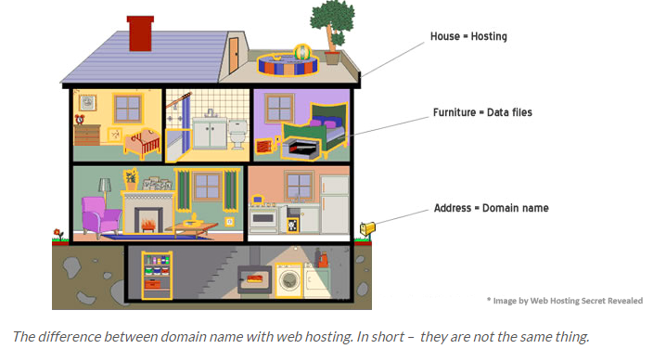
Sub Domains
mail.yahoo.com
A domain must be unique; while for sub domains, users can freely add it on top of the existing domain as long as their web host provide the service.
However, this is not the case to many including the search engines – it is known fact that the search engines (namely, Google) treat sub domain as a different domain independent from the primary domain.

Slide 10




Domain Name
You do not need to this for the assignment
You have to first reserve a domain name for your company.
There are service providers to reserve the domain name.
Eg:
InMotion Hosting -> website hosting + also domain registration service.
GoDaddy ->the world largest domain registrar + different web hosting services.
Nameecheap.com
A lot more ++++++
Domain registration process are governed by the Internet Corporation for Assigned Names and Numbers, or ICANN.

Slide 11
In Sri Lanka
http://www.nic.lk/ or https://www.instra.com/en/domain-names/sri-lanka/lk-domain-registration/lk - if you need .lk domain name.
Can use any other provider like Godaddy for any other name like .com,.edu etc.

Slide 12
WHOIS Data
Every domain name has a publicly accessible record that includes the owner’s personal information such as owner name, contact number, mailing address, and domain registration as well as expiry date.
It’s called a Whois record and lists the registrant and contacts for the domain.
As required by the Internet Corporation for Assigned Names and Numbers (ICANN), the domain owners must make these contact information available on WHOIS directories. These records are available anytime to anyone who does a simple WhoIs lookup.
https://www.domains.lk/domainsearch/ - LK Whois search

Slide 13
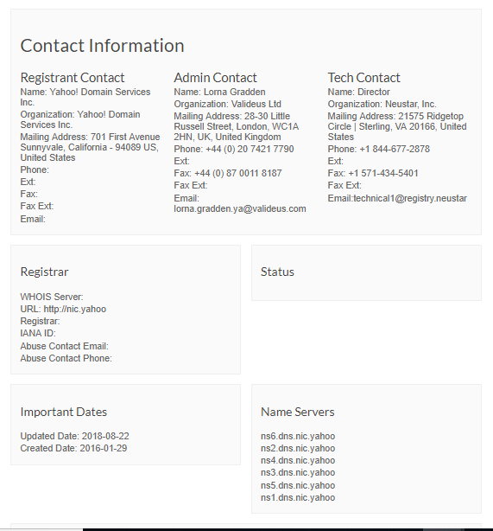
WHOIS example
https://whois.icann.org/en

Slide 14
Web Host
A web host stores the documents that make up a website.
Web servers are computers connected to the internet.
A web host, or web hosting service provider, is a business that provides the technologies and services needed for the website or webpage to be viewed in the Internet.
Each web server (an actual computer) can host dozens, hundreds or thousands of sites.
You pay a host to store and deliver your site's files.
All in one example : Website.com

Slide 15

Types of Hosting

Slide 16
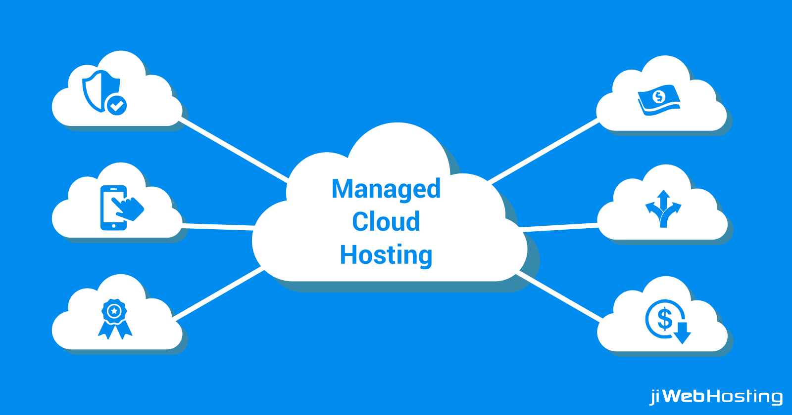
Cloud Hosting
The most reliable hosting type
Files and resources are replicated on each server. When one of the cloud servers is busy or has any problems, the traffic is automatically routed to another server in the cluster.
Powerful, reliable and very affordable
Backups are typically an add-on
Price is based on the plan you configure (memory, disk etc)

Slide 17
Example Free Hosting services
You need to this for the assignment
Firebase Hosting – tutorial is in the LMS
Google Cloud – using google drive
https://www.process.st/how-to-host-a-website-on-google-drive-for-free/

